Slide 1

AI4SD Hackathon
Defect detection in Graphene Sheets
Group 5. Anna Bachs Herrera, Abdoulatif Cisse, Emilio Alexis de la Cruz Nuñez Andrade, Philipp Deussen, Ivan Yankov
This network is EPSRC Funded under Grant No: EP/S000356/1

Slide 2
Index
Introduction
Workflow
Results
Conclusions & Future Work
AI4SD Hackathon

Slide 3
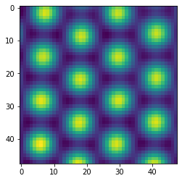
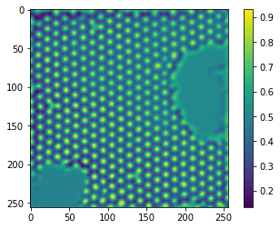
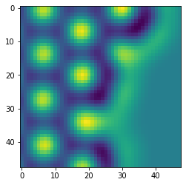
Introduction
Perfect patches
2279 patches
48x48
Classification:
Defect
No defect
Defect patches
32 patches
48x48
180 micrographs
256x256
AI4SD Hackathon

Slide 4

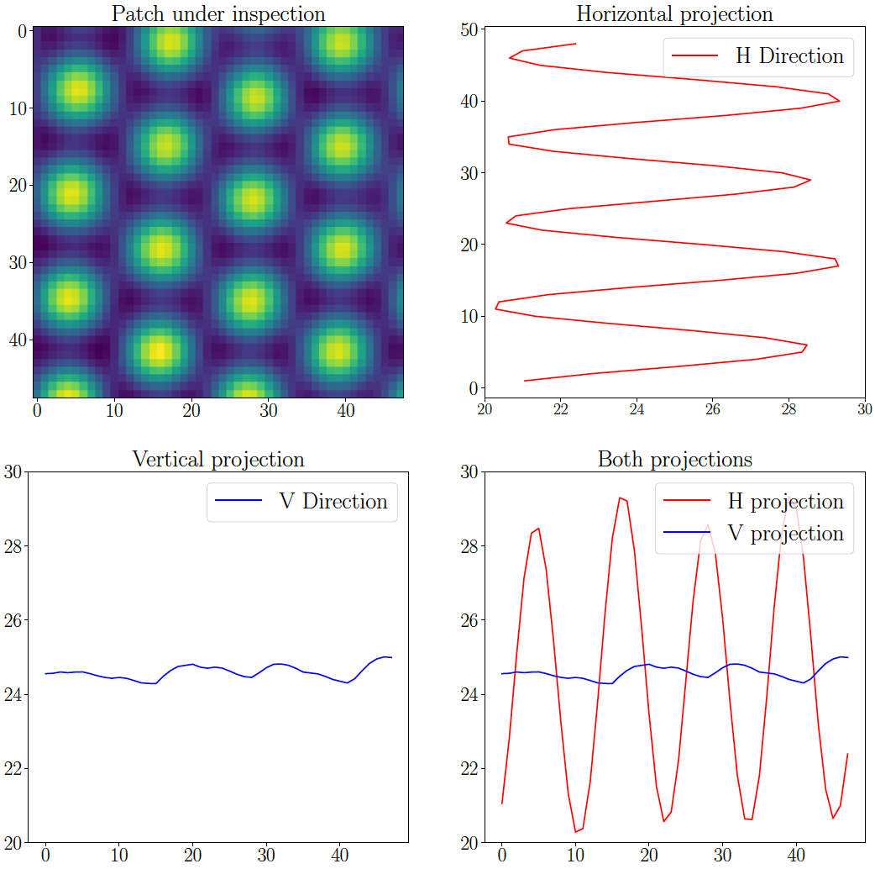
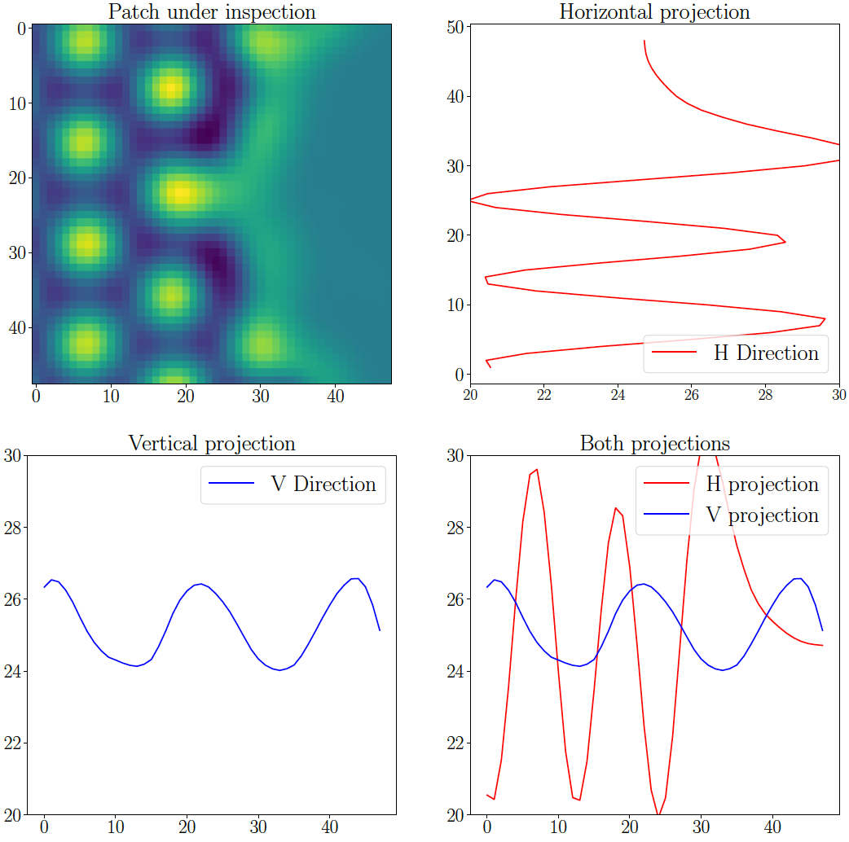
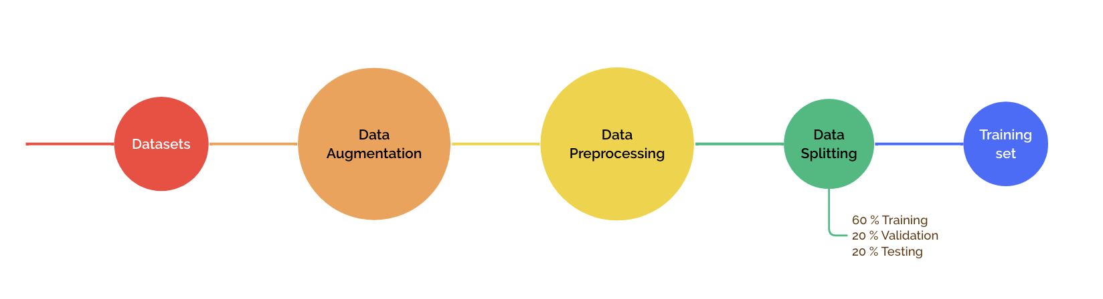
Workflow
Perfect: 2000
Defect: 2000
Perfect: 2279
Defect: 32
AI4SD Hackathon

Slide 5
Workflow
AI4SD Hackathon

Slide 6
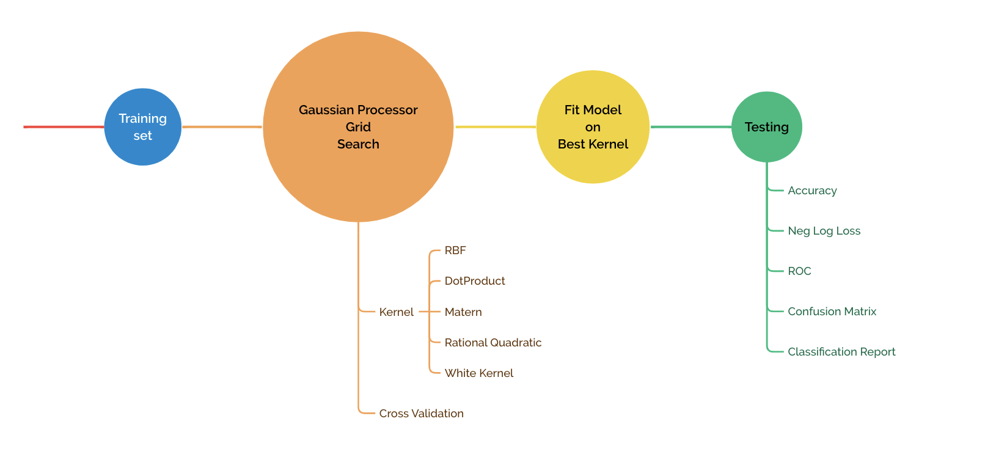
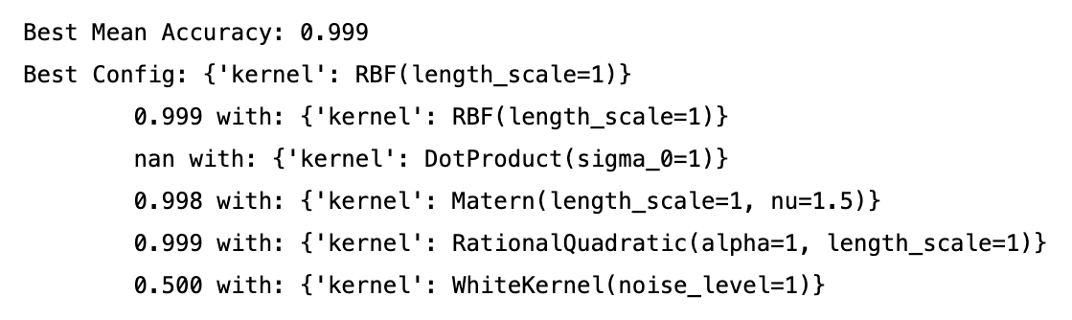
Workflow
Validation Set
Training Set
AI4SD Hackathon

Slide 7



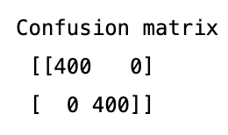
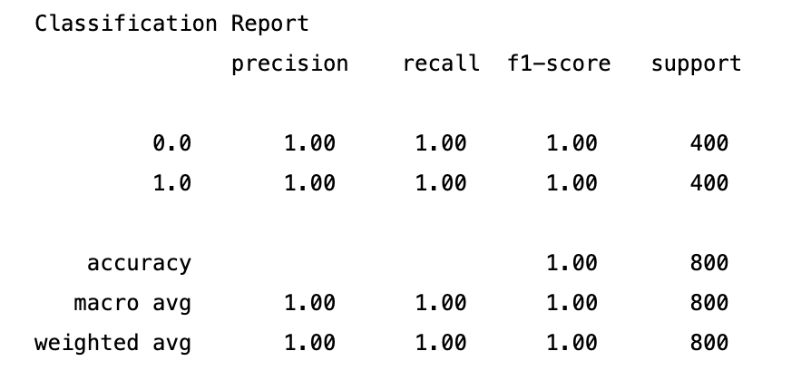
Workflow - Results
AI4SD Hackathon

Slide 8
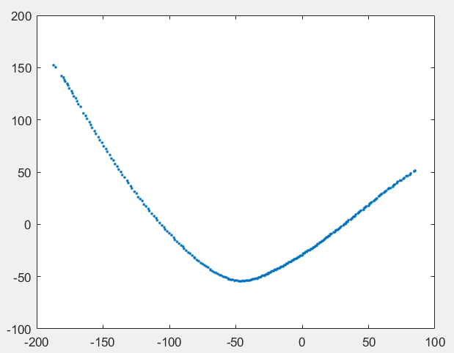
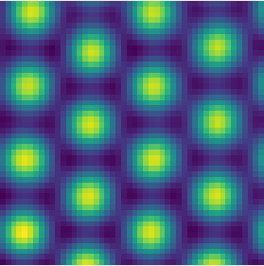
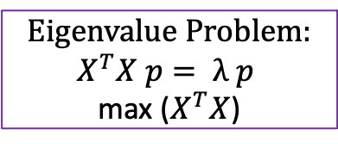
Other attempt: PCA model for image analysis
Display Graphene images
Identify principal component
Edge detection
RGB density
To visualise: 2 PC’s
Eigenvalue Problem:
$$X^{T}X p= λ p$$
max ($X^{T}X$)
AI4SD Hackathon

Slide 9
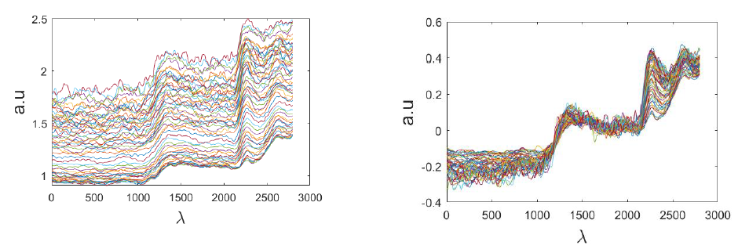
PCA model for image analysis
4. Train model on ca. 2000 perfect Graphene images
5. Pre-process across the number of batches (images)
AI4SD Hackathon

Slide 10
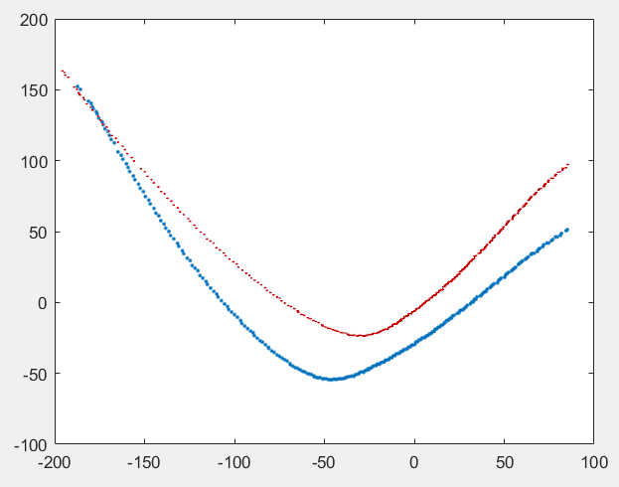
PCA model for image analysis
5. Test new images against the correct PCA shape
6. Differences in scores reflect a difference of images
Trained shape (correct) | Defected shape
AI4SD Hackathon

Slide 11
Conclusions & Future Work
Small dataset
Relevant features extracted
AI4SD Hackathon

